Slide 1
Final Project
Outlook of the US economy, Stock Predictions, Trading Strategy and Automated Bot
Carlos Muñoz Fresco

Slide 2
Contents
01
Insight to the US economy
Data obtained from TradingView
02
Prediction Model
Predicting the U.S. stock market (S&P 500 and NASDAQ 100), Gold and Bitcoin – Fitting the Prophet() model
03
Trading Strategy
Creating a strategy for crypto trading
04
Trading bot
Deploying a crypto trading bot, connected to Bybit’s API

Slide 3
Variables
Credit Cycle
Growth Cycle
10 Year Bond minus 2 Year Bond Spread
Interest Rates
Dollar index strength (DXY)
Volatility index (VIX)
Gross Domestic Product (GDP) Change YoY
Manufacturing Purchasing Managers Index (PMI)
Unemployment Rate
Inflation Cycle
Liquidity Cycle
Consumer Price Index (CPI) Change YoY
Monetary Supply (M2)

Slide 4
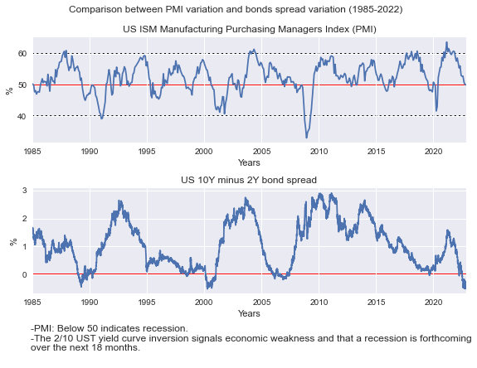
Indicators show the recession is just starting…
PMI
Measures the number of manufacturing activity leads that were produced in the previous month. This data is considered a very important economic and confidence measure.
10Y Bond minus 2Y Bond Spread
With increases in interest rates the value of all assets such as bonds go down. Due to this expected interest rate hike, investors who held US 2 year treasury bonds start selling them. The sell-off brings down the price of 2 year US treasury bonds. Decline in price results in increases in yield.

Slide 5
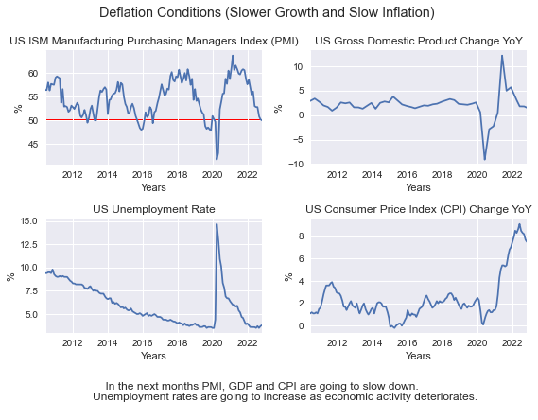
Current Market Conditions
SELL
BUY

Slide 6
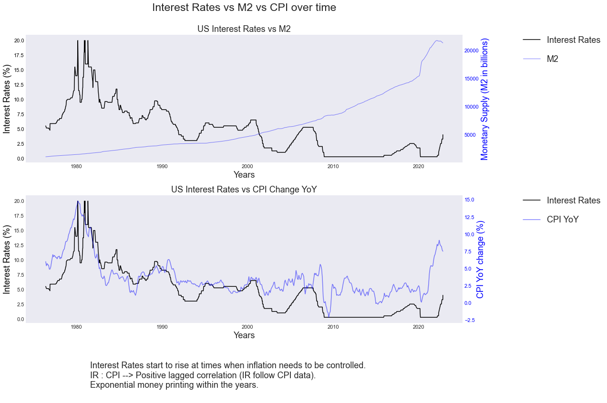
Identifying Long Term Trends

Slide 7
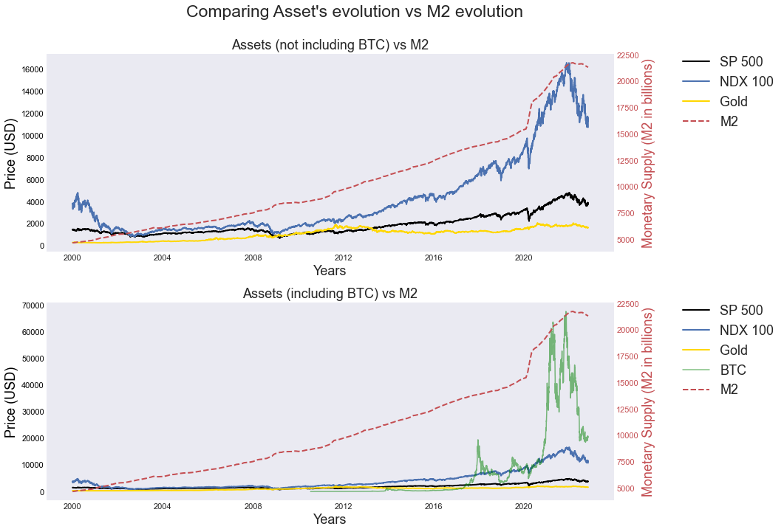
Is money printing the main incentive for higher asset prices?
Weakness
Get a modern PowerPoint Presentation that is beautifully designed. I hope and I believe that this Template will your Time.
You can simply impress your audience and add a unique zing and appeal to your Reports.
SWOT
Opportunity
Get a modern PowerPoint Presentation that is beautifully designed. I hope and I believe that this Template will your Time.
You can simply impress your audience and add a unique zing and appeal to your Reports.

Slide 8
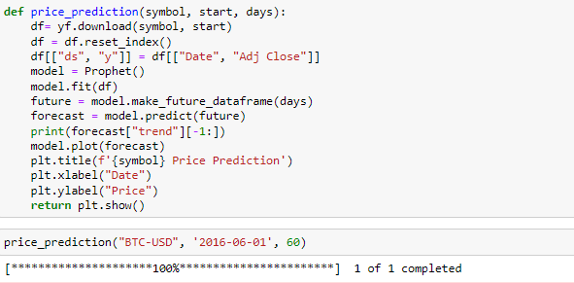
Prophet()
Prediction Model

Slide 9
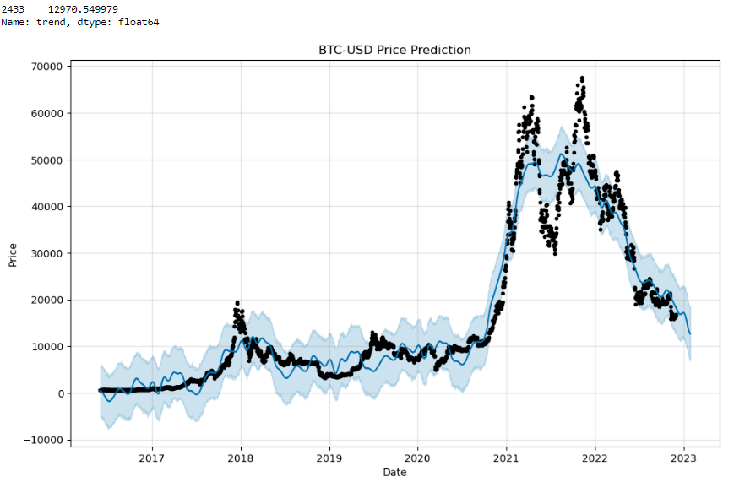
Bitcoin price prediction
Weakness
Get a modern PowerPoint Presentation that is beautifully designed. I hope and I believe that this Template will your Time.
You can simply impress your audience and add a unique zing and appeal to your Reports.
SELL
SWOT

Slide 10
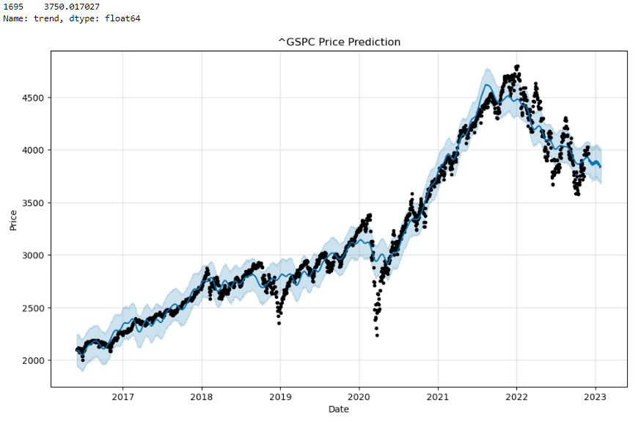
SP 500 price prediction
SELL

Slide 11
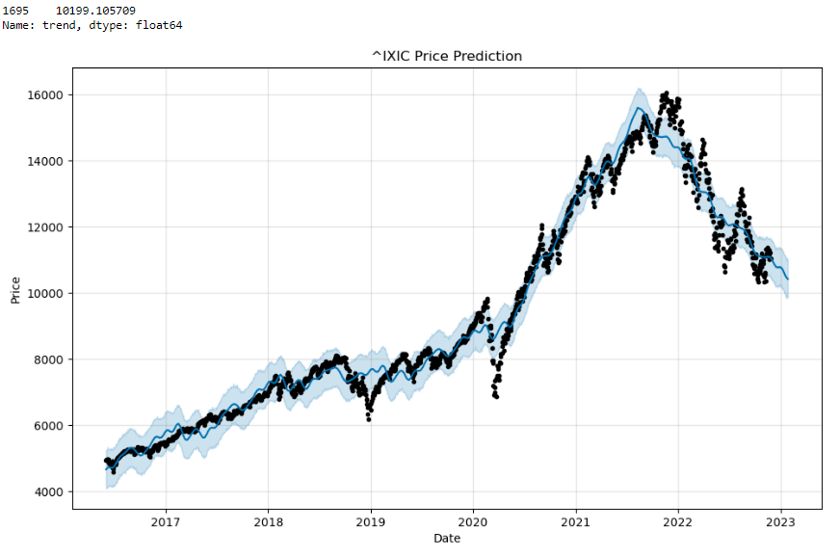
NASDAQ 100 price prediction
SELL

Slide 12
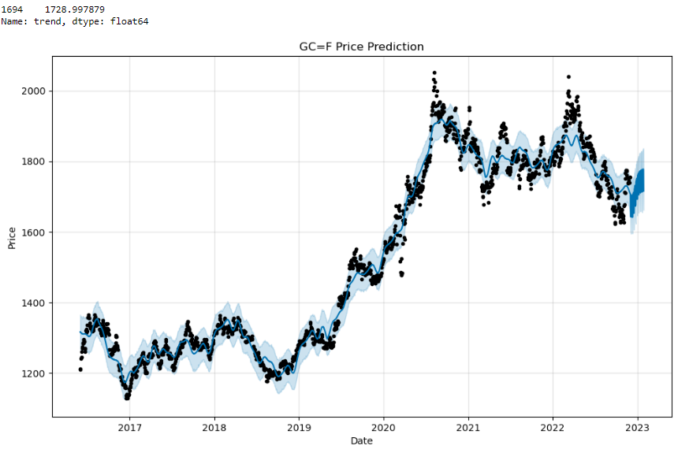
Gold price prediction
SELL

Slide 13
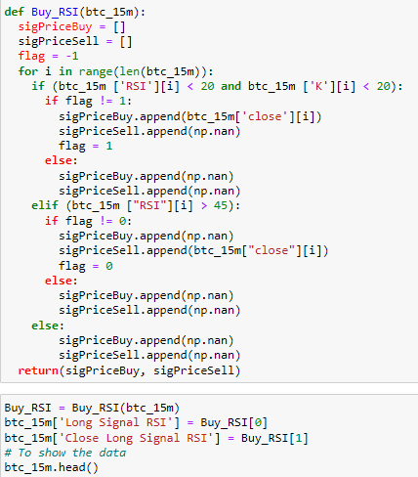
Trading Strategy & Bot
Asset: BTC (15 minutes timeframe)
Buying Conditions
RSI < 20 (Oversold conditions)
K < 20 (Low momentum)
Selling Conditions
RSI > 45
BUY
SELL
Bearish Trend
I wanted to catch small movements and get quickly out of trades.

Slide 14
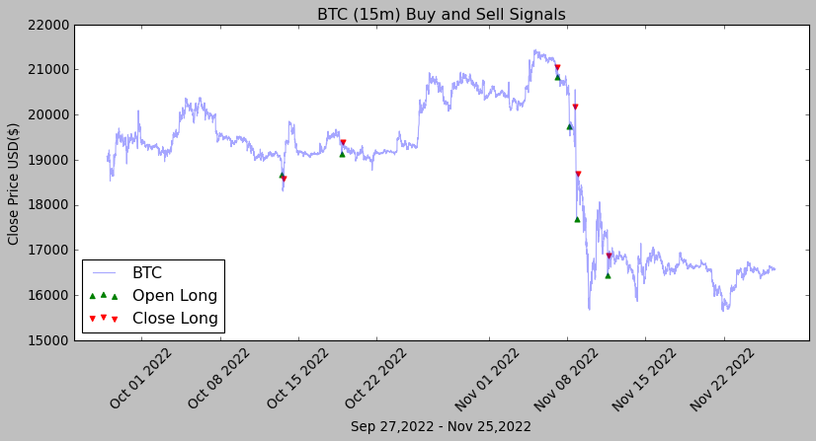
Back testing Results
SLIDE
3
4
2
1
5
6
We Create Quality Professional
PPT Presentation

Slide 15

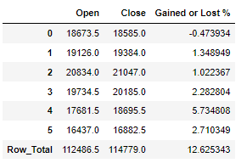
Results

